Slide 1
1
E-Commerce Sales
Dashboard Analysis
Data driven Business Insights
1
Presented by Harini Mallena/Excel Project/Student/Upcoming Data Analyst

Slide 2
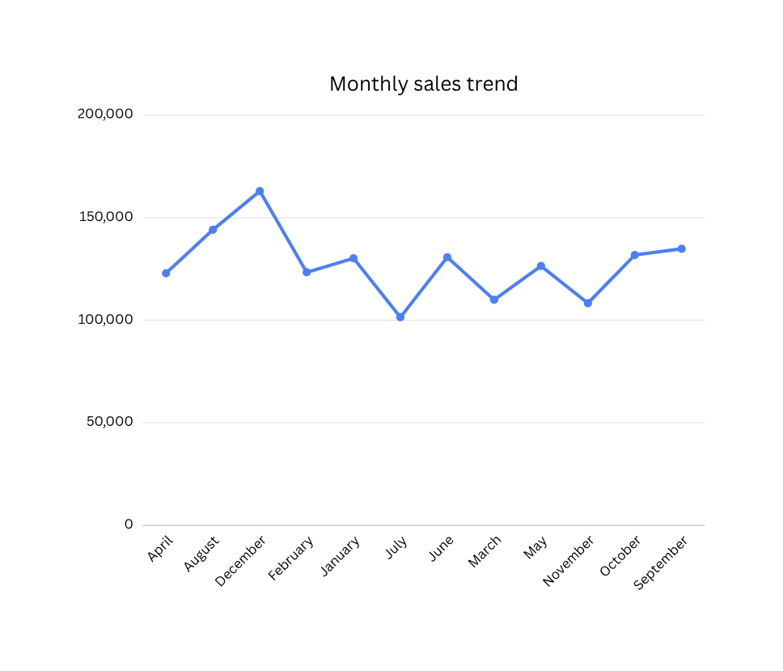
How did sales perform throughout the year?
Sales fluctuate across months, with peak performance in December month
This helps identify seasonal trends and planning strategies
2

Slide 3
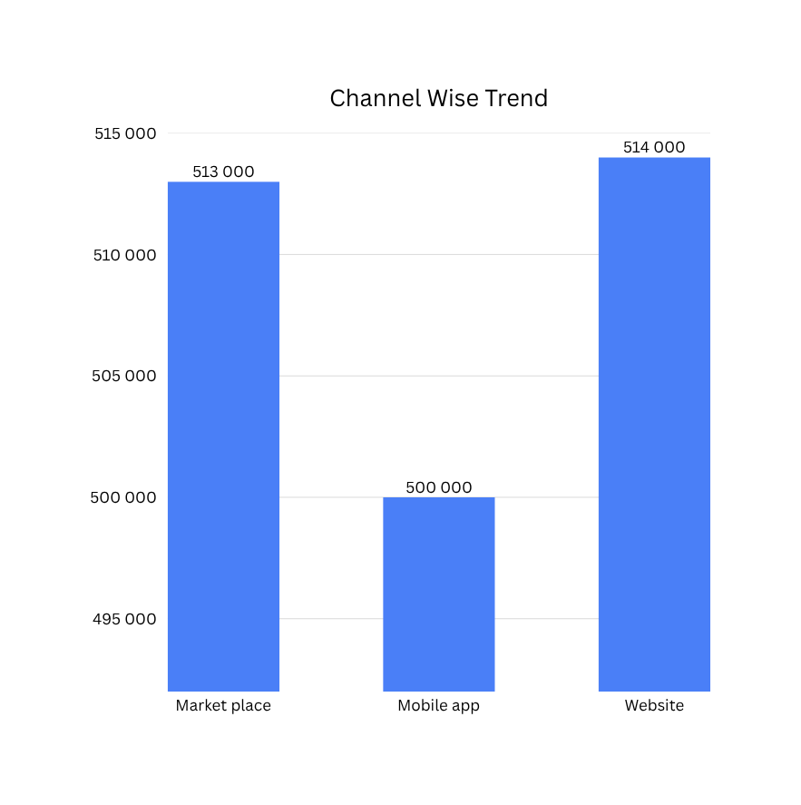
Which sales channel performs best?
Website and Market place Channels generate
higher revenue than the mobile app.
This suggests customers prefer web-based purchases
3

Slide 4
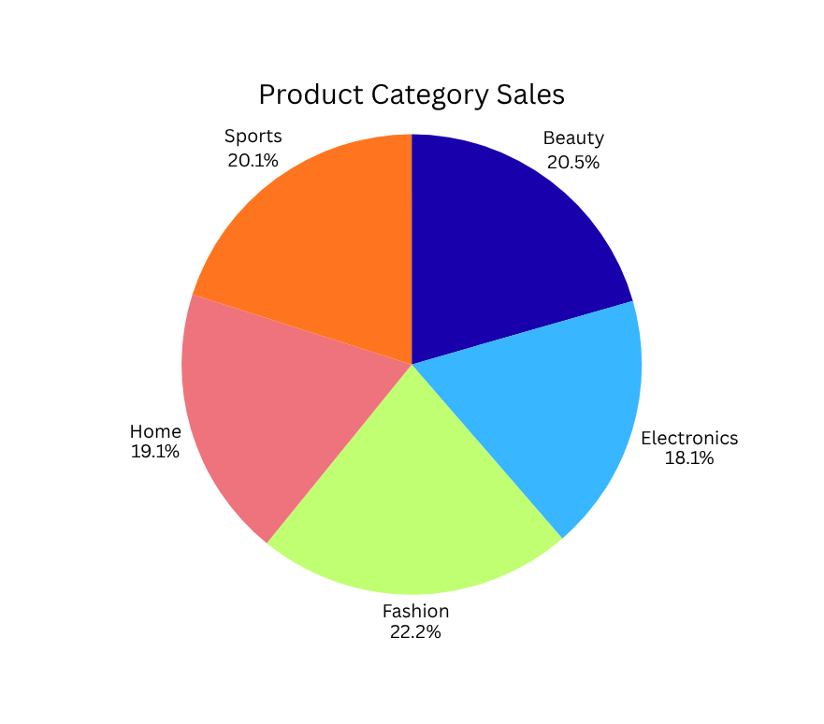
Which Product category contributes the most revenue?
Fashion and Beauty categories contribute
the highest sales.
This indicates strong customer demand in these segments.
4

Slide 5
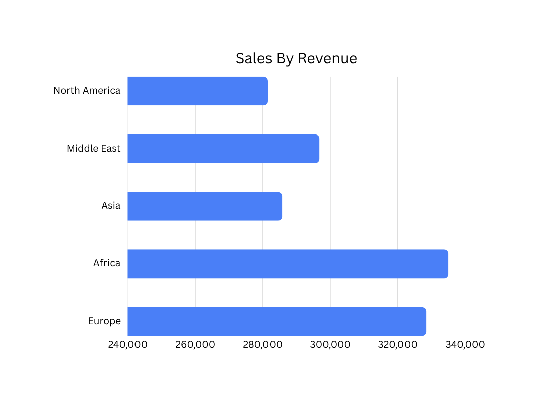
Which region generates maximum revenue?
Africa and Europe generate higher sales
compared to toehr regions.
This shows strong regional market presence.
5

Slide 6
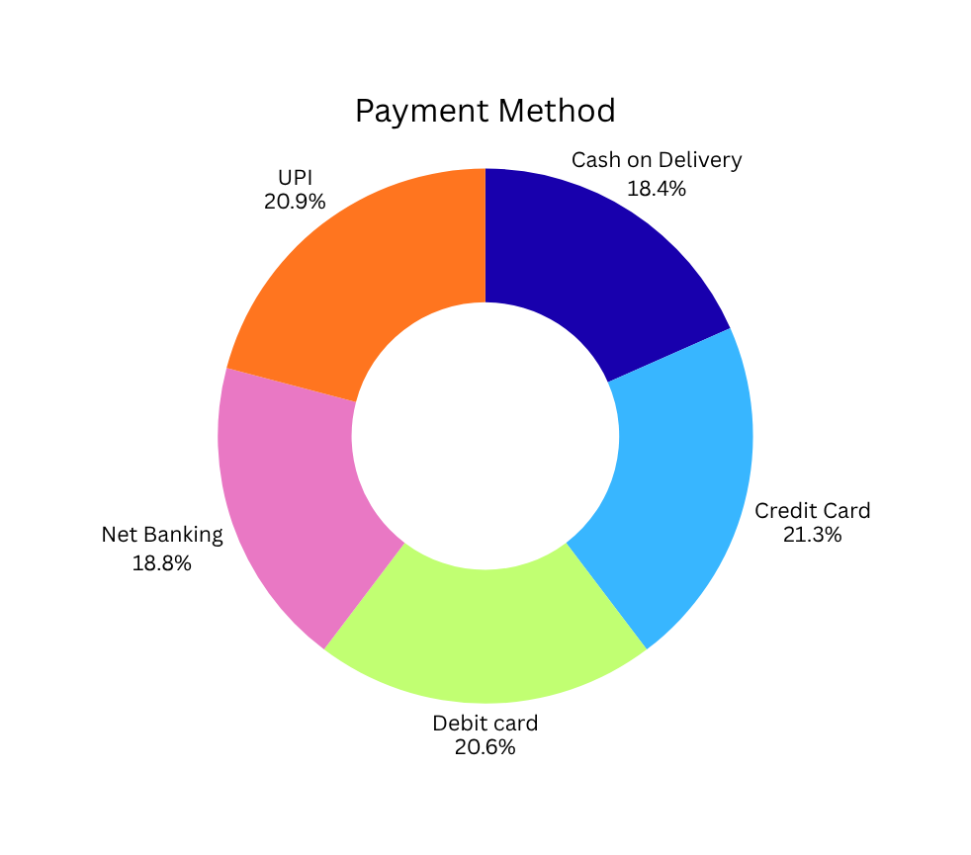
Which payment method is most preferred?
Credit card and UPI are the most preferred payment methods.
This indicates increasing digital payment adoption.
6

Slide 7
2
Profit & Probability Dashboard
Analying margins and product performace to maximize profitability.
7

Slide 8
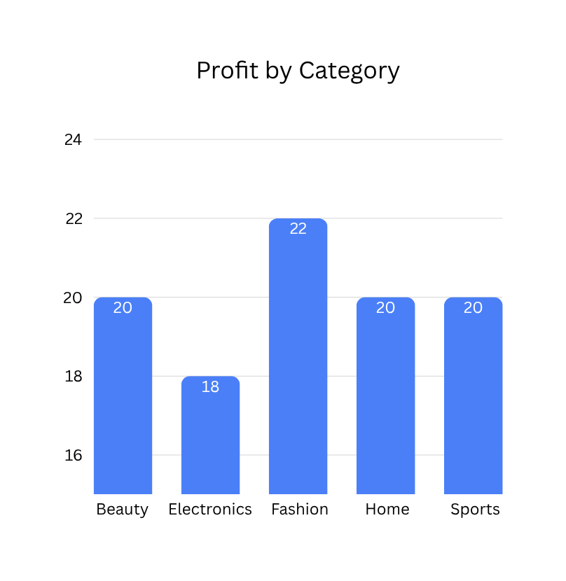
Which product category has the highest profit margin?
Fashion and Beauty categoy shows the highest profit
margin, followed by Sports and Home.
This suggests that Fashion products are priced
efficiently and generate better returns.
8

Slide 9
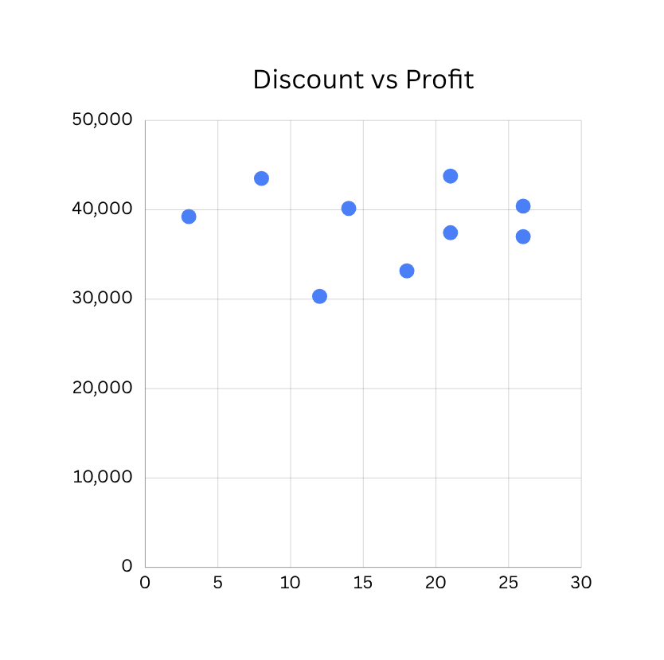
How does discount impact profit?
The Scatter plat shows that moderate discounts
still maintain good profit levels.
However, higher discounts may slightly reduce profit margins.
9

Slide 10
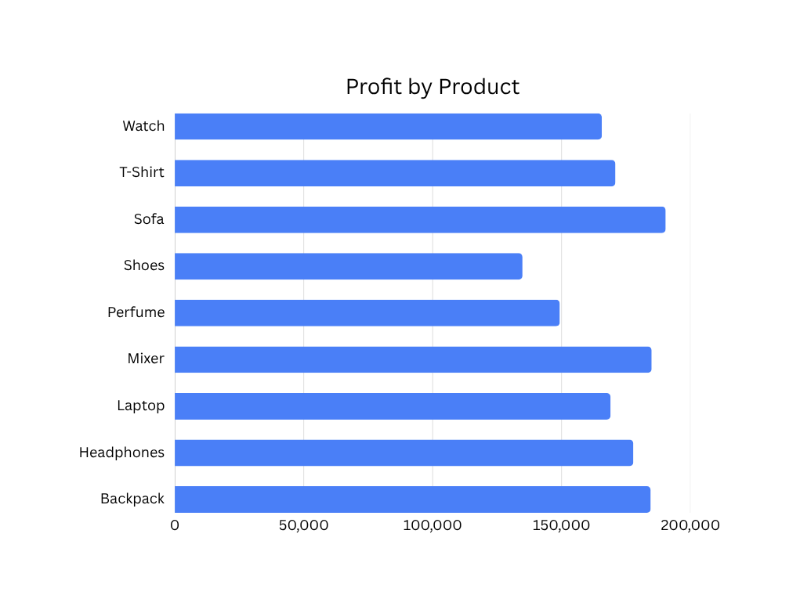
Which product contributes more profit returns?
Sofa and Mixer generate higher profits compated
to other products.
This indicates strong demand in these product lines.
10

Slide 11
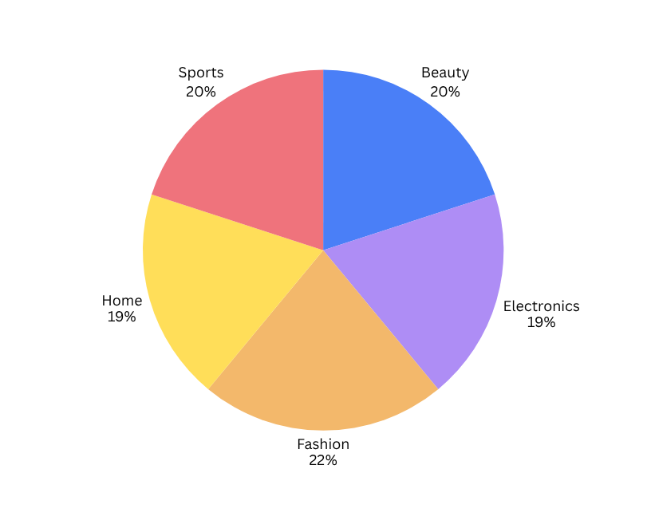
Which category has the highest product contribution?
Fashion category contributes the highest share,
around 22% followed by Beauty and Sports.
This shows balanced product distribution across categories.
11

Slide 12
3
Customer Analysis Dashboard
Understanding customer behaviour to enhance growth and retention strategies.
12

Slide 13
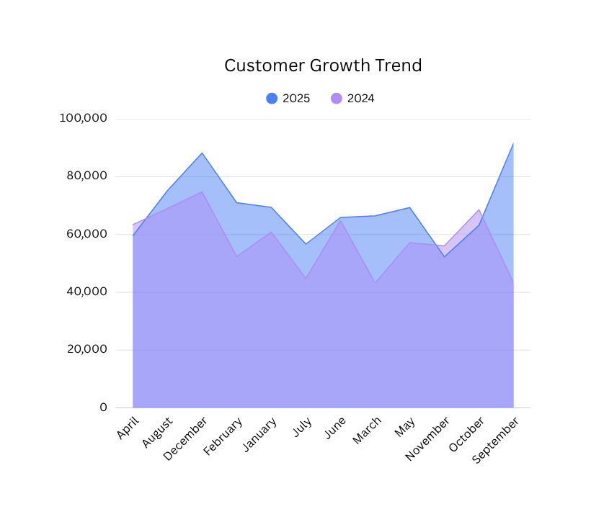
How has customer revenue grown over time?
Customer revenue shows fluctuations across months, with noticaeble peaks in certain months.
This indicates seasonal deamand patterns.
13

Slide 14
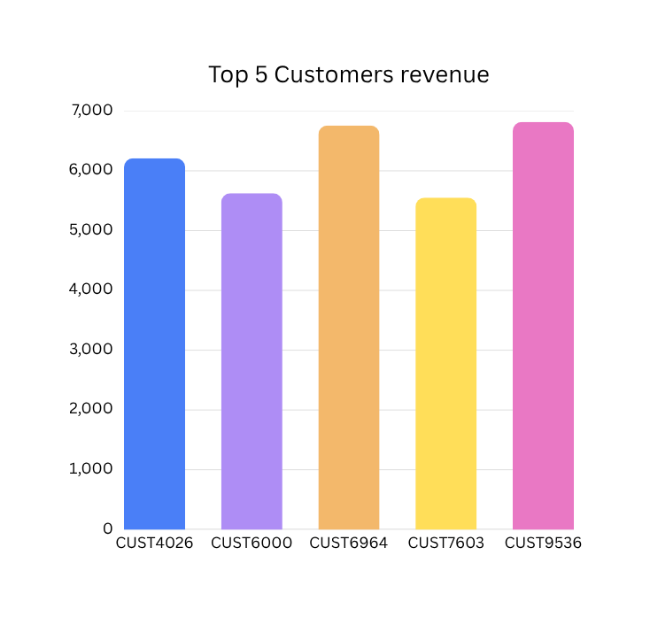
How was the revenue of Top 5 customers?
The Top 5 customers significantly contribute to overall revenue,
with CUST9536 being the highest contribute.
This shows that a small group of customers generates major revenue.
14

Slide 15
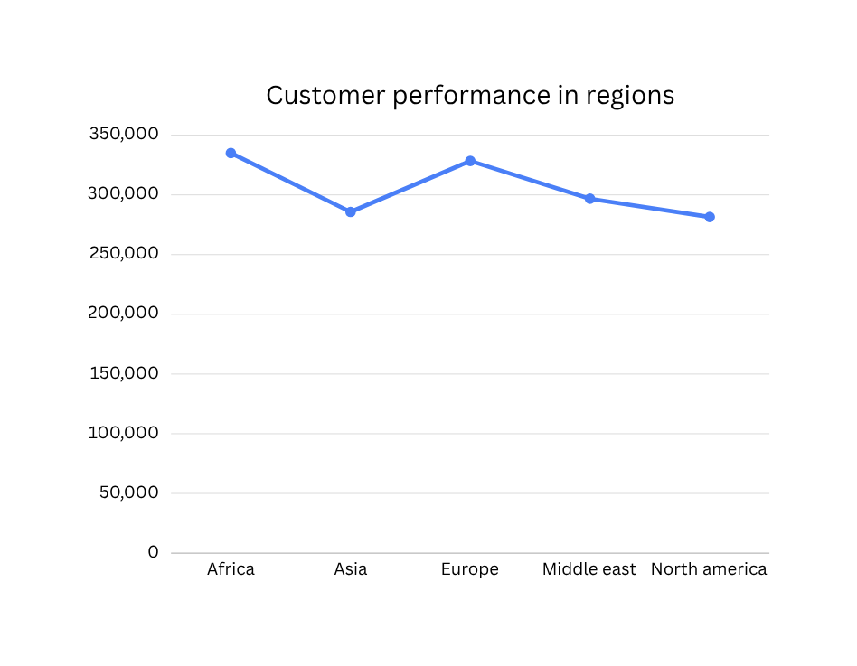
Which region of customers generates highest revenue?
Africa and Europe generate higher revenue
compared to other regions.
North America shows comparitively lower revenue.
This indicates strong market presence in specific regions.
15

Slide 16
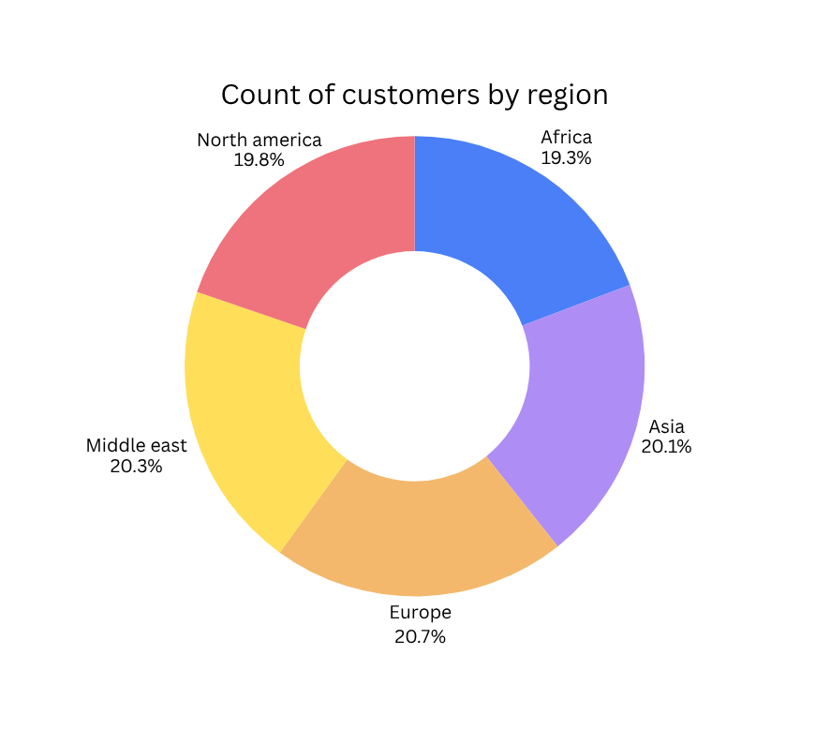
How are customers distributed acroos regions?
Customer distribution is fairly balanced across regions,
with Europe slightly leading.
This shows gloabl customer presence without heavy
dependence on one region.
16

Slide 17
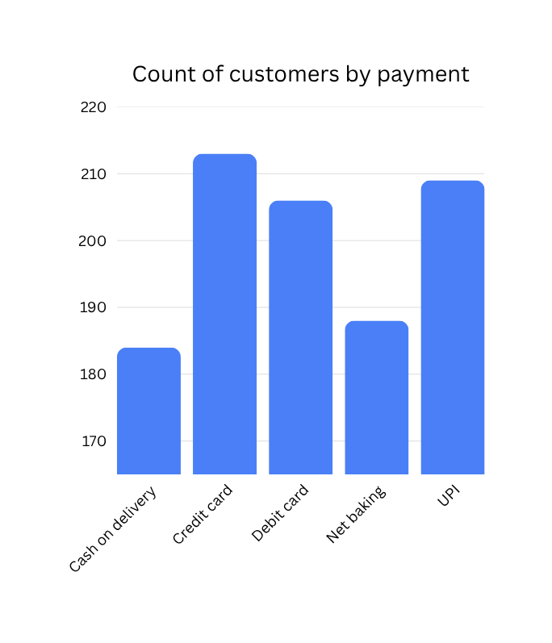
Which payment method is most preferred by the customers?
Credit card and UPI are among the most preferred payment methods,
followed by Debit card.
This indicates strong adoption of digital payment systems.
17

Slide 18
*Final conclusion
1.Sales performance
Sales show seasonal fluctuations across months.
Certain months consistently generate higher revenue.
Website and Market place channels perform better than Mobile app.
2.Product performance
Fashion and Electronics categories contribute higher sales.
Mixer and Sofa are top performing products.
Shoes generate lower profit and need improvement strategy.
18

Slide 19
3.Profitability Analysis
Fashion Category has the highest profit margin.
Discounts impact profit levels and must be managed carefully.
Balanced pricing strategy is essential for sustainable growth.
4.Customer Insights
Revenue is evenly distributed across regions.
Africa and Europe show strong revenue contribution.
Repeat customers are limited-retention strategies can be improved.
Digital payment methods are highly preferred.
19

Slide 20
Thank
you!
20

